Slide 1

Audiobooks by Audible
A web scraping project By James Welch

Slide 2
Background
Growing Market
Global Player
Subscription
Notes:
Global audiobook market size was 2.67 billion in 2019 and is expected to compound by 25% per year to 7 trillion in the next decade
Audible is a publisher and distributor of audiobooks and podcasts, the largest in the U.S and some presence in other countries
Audible reports +200,000 audio programs and over a billion hours listened a year.
Currently Audible provides two pricing tiers at $7.95 and $14.95 per month.
Both tiers provide access to Audible Originals, the higher tier includes a monthly audiobook credit.

Slide 3
Amazon & Books
Author’s Journey
Amazon Publishing
Kindle Direct
Ala carte printing
Distribution
Audio Creation Exchange (ACX)
Text to Audio
Distribution
Goodreads
Reviews
Organic Search
Amazon (Books)
Purchase
Reviews
Audible
Purchase
Reviews
Reader’s Journey

Slide 4
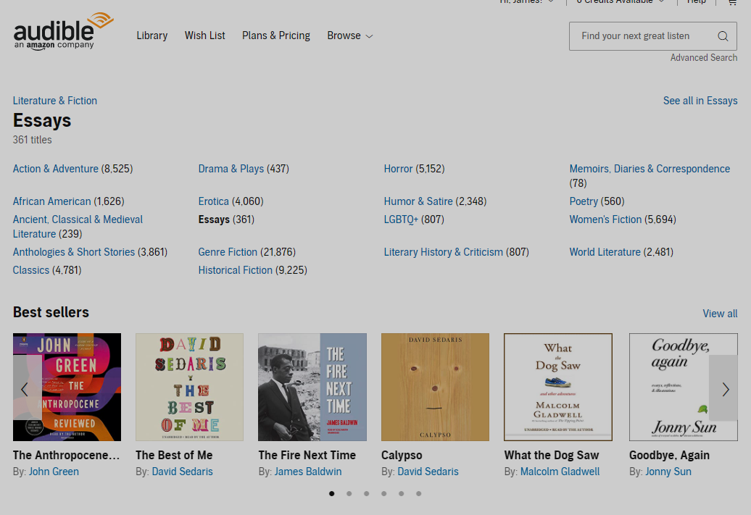
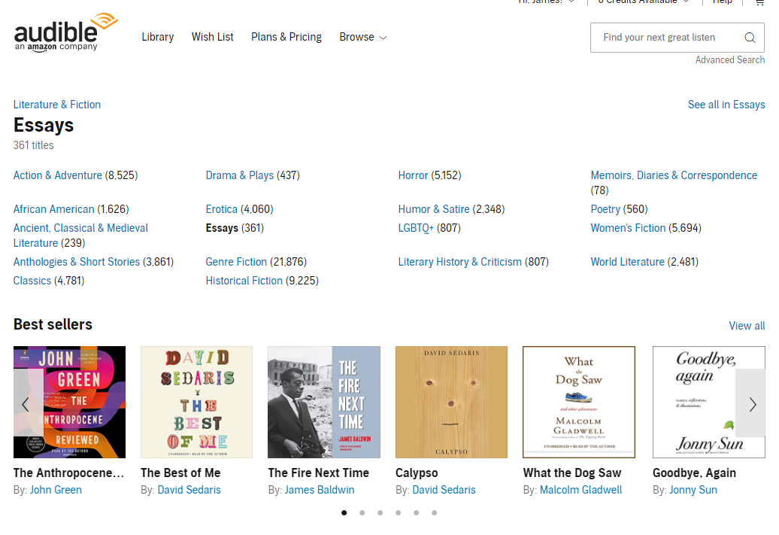
Category Scraping
Parent Category
Alt: Results Page URL
Category Name
Number of titles
Sub-Categories
Bold: No Sub-Categories
Results Page URL

Slide 5
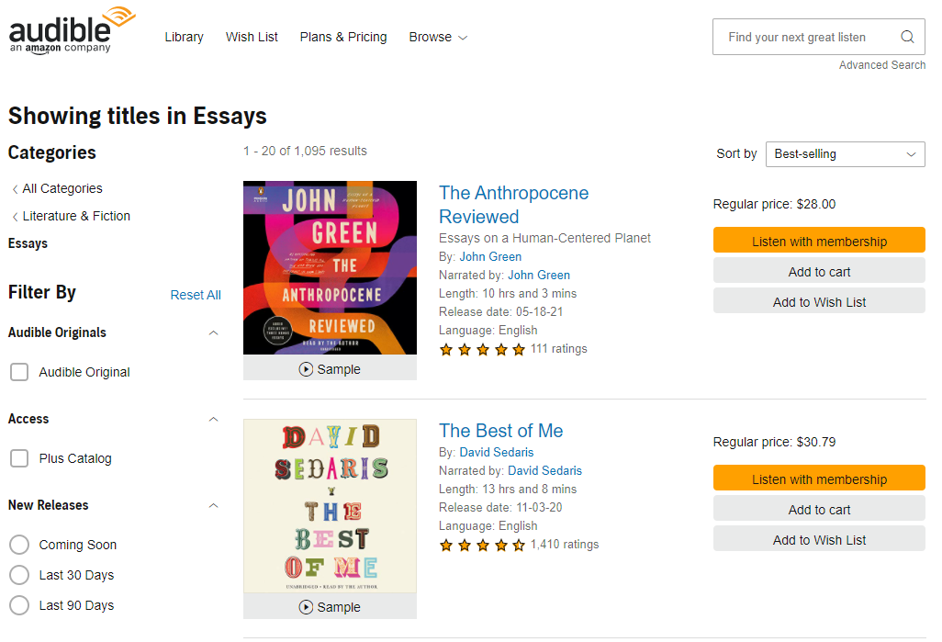
Title Scraping
Category Name
Title Information:
Title
Subtitle
Author
Narrator
Length
Language
Star Rating
Number Ratings
Price

Slide 6
Category Page:
Search Results Page:

Slide 7
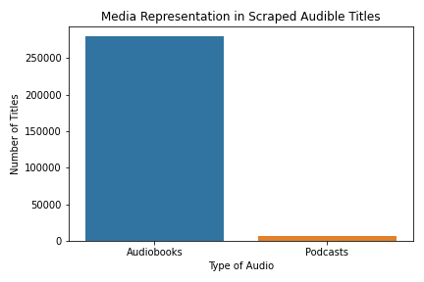
Collected Titles
622,065 titles scraped.
279,240 unique audiobooks.
6,960 incidentally scrapped podcasts.

Slide 8
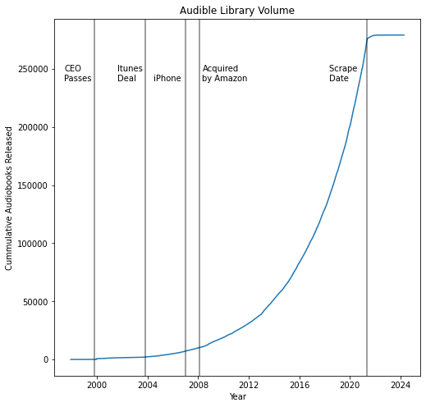
Growing Library
Growing Exponentially.
Steady Growth since 2000.
iTunes Deal & Amazon assisted growth.

Slide 9
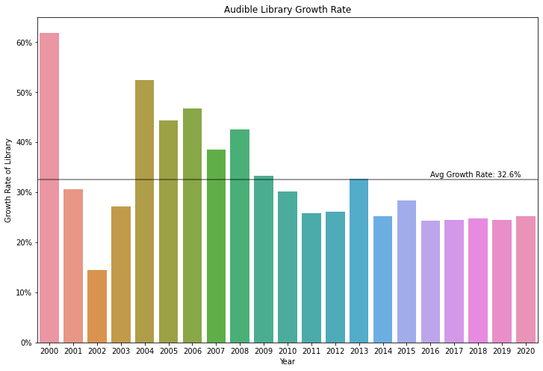
Consistent Yearly Growth
Growth stabilizing at 24%.
2013 increase likely due to growth of ACX.
1997-1999 not shown.
((Current Year – Previous Year ) / Previous Year) * 100 = Rate
Notes:
17-

Slide 10
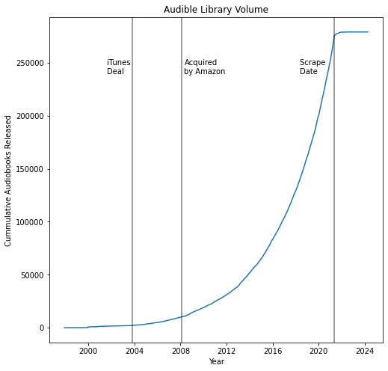
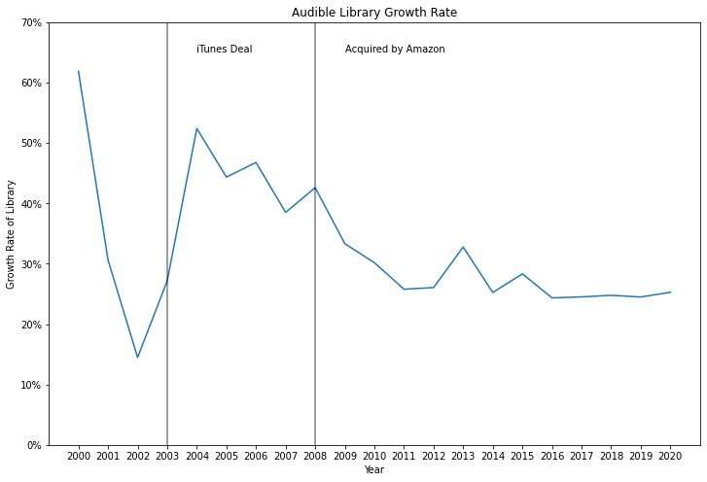

Slide 11
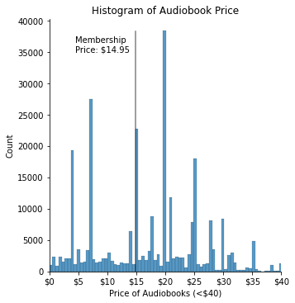
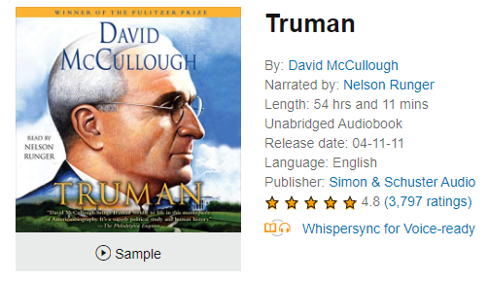
Price
Full Audible Membership: $14.95 / month.
57% of audiobooks are more expensive.
A La Carte Price | Number of Audiobooks
$19.95 | 35103
$6.95 | 24551
$14.95 | 22088
$3.95 | 16737
$24.95 | 15953
$115.95
2539 audiobooks excluded

Slide 12
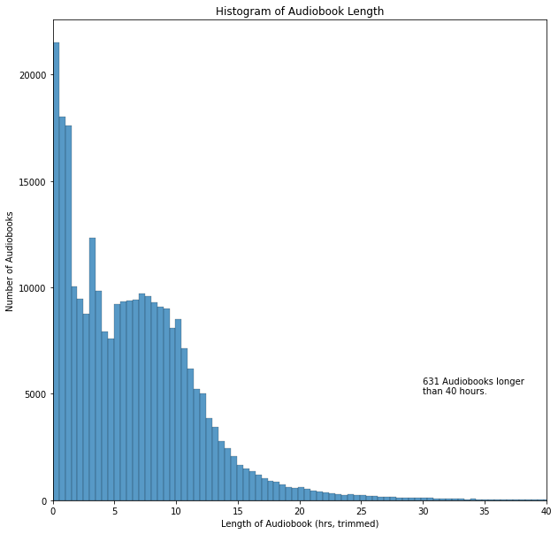
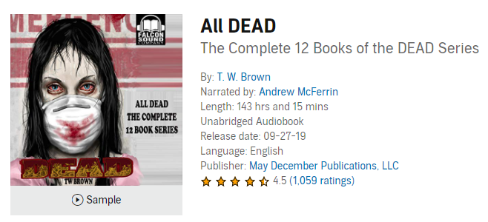
Length
Median audiobook length is 6 hours with a long tail.
Lengths determined lazily (on first listen).
Longest audiobook clocks in at 143 hours.

Slide 13
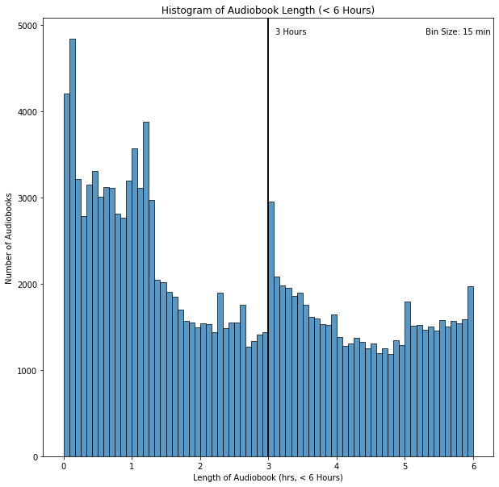
3 hours: deep dive
A Y combinator blog reported 3 hours as the cutoff for a royalty increase.
No evidence for differences in royalty rates.
Platform sets prices, ACX provides expected pricing table.
1-3 hours: $6.95
3-5 hours: $14.95
5-10 hours: $19.95

Slide 15
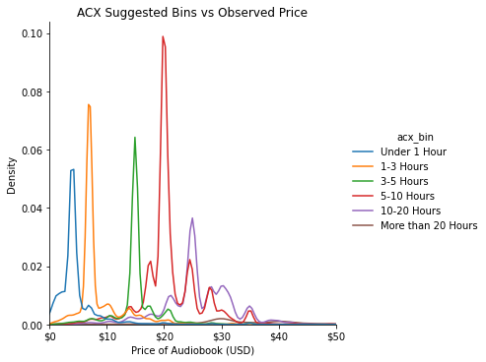
Price & Length
Length (Hours) | ACX suggested | Observed Pricing
< 1 | < $7 | $3.95
1 – 3 | $7 – $10 | $6.95
3 – 5 | $10 - $20 | $14.95 *
5 – 10 | $15 - $25 | $19.95
10 – 20 | $20 - $30 | $24.95
20+ | $25 - $35 | $29.95
* Audible Monthly Membership Price

Slide 16
Price & Length

Slide 17
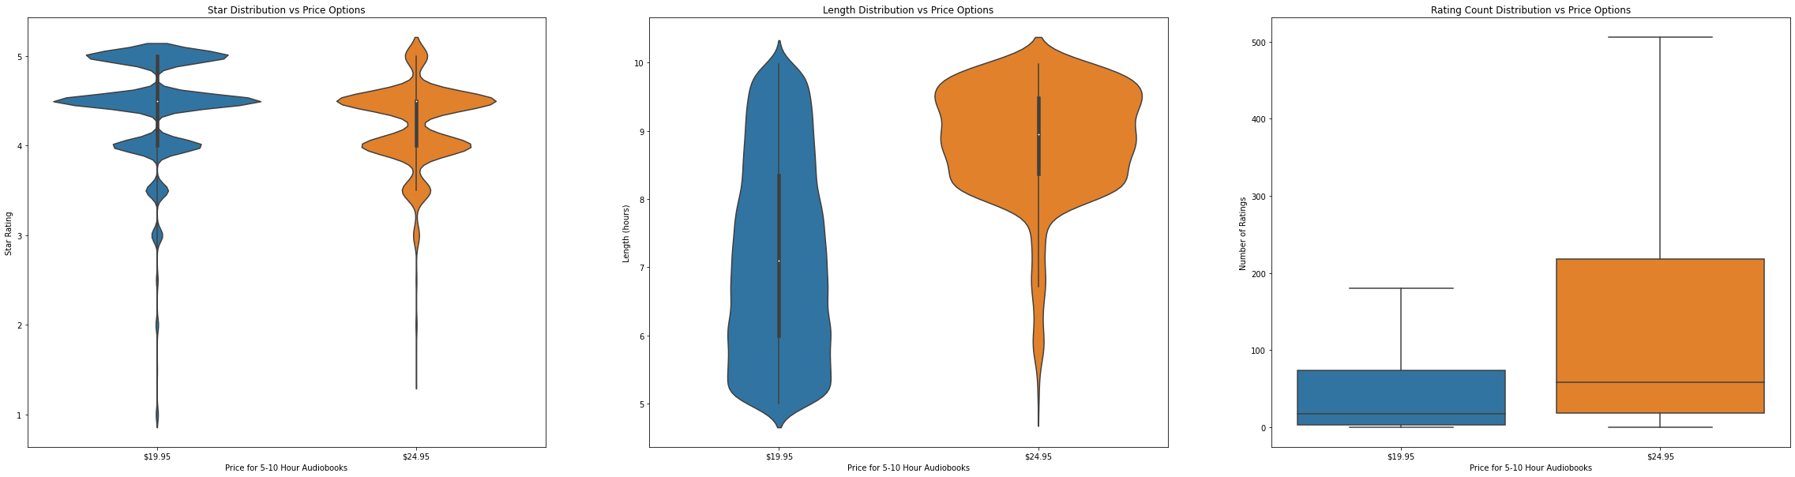
Price & Length
While books lengths are binned together, they are assigned different prices. Comparing $19.95 & $24.95 from the 5-10hr bin. We can see that the main differences are the length and number of reviews.
Star Rating
Audiobook Length
Number of Ratings
$19.95
$24.95
$19.95
$24.95
$19.95
$24.95

Slide 18
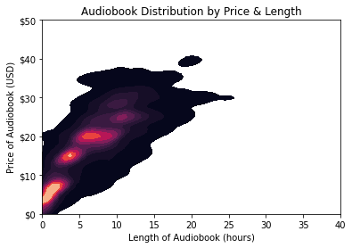
Price & Length
Price and Length positively correlated at ~ $2.50/hr.
Hot-spots agree with ACX pricing.
Modeling to understand relationship with other variables.

Slide 19
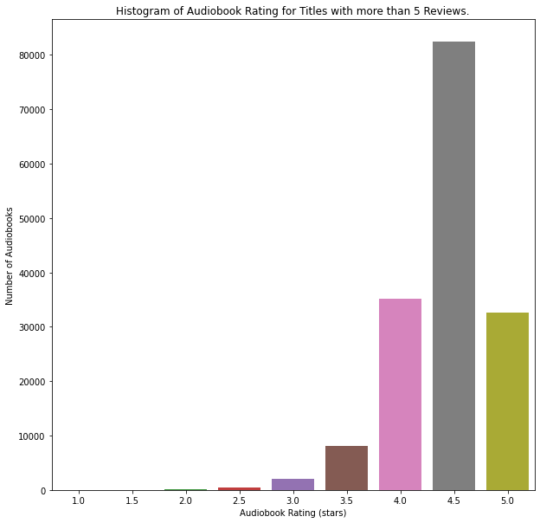
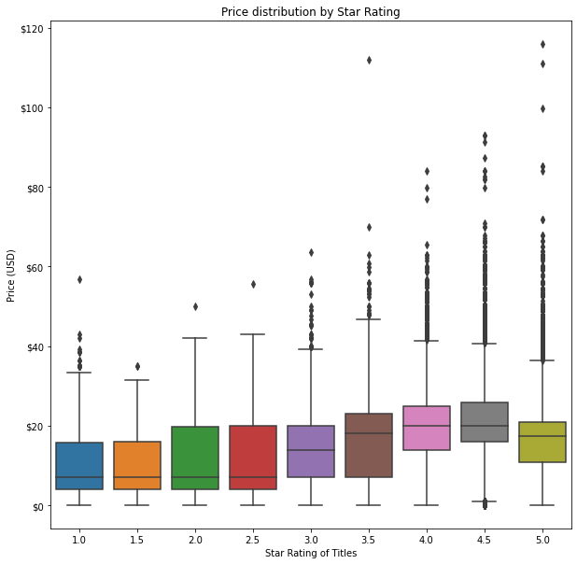
Ratings & Reviews

Slide 20
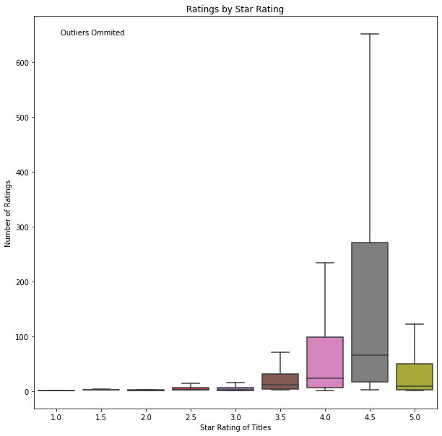
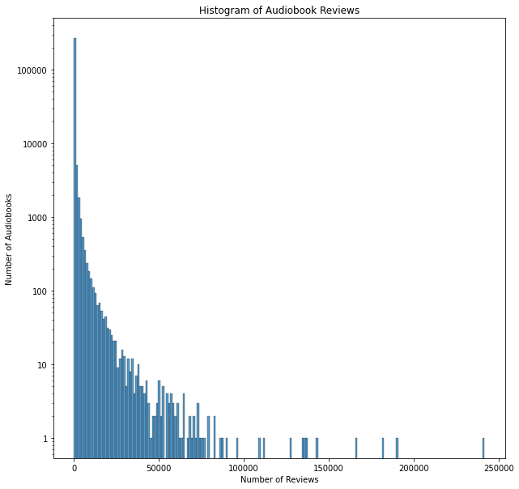
Ratings & Reviews
Ready Player One
Where the Crawdads Sing
Born a Crime
Becoming

Slide 21

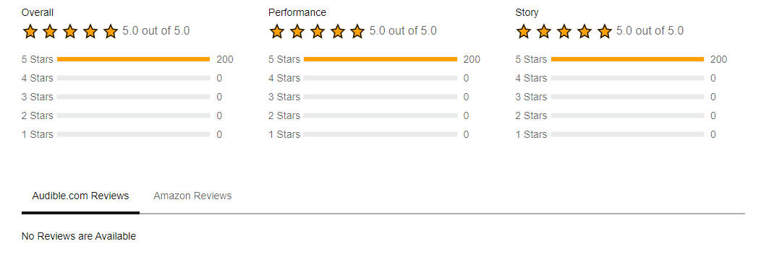
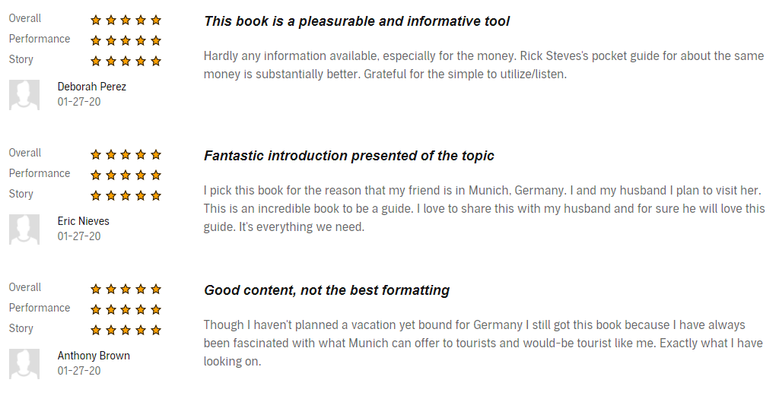
Ratings & Reviews

Slide 22
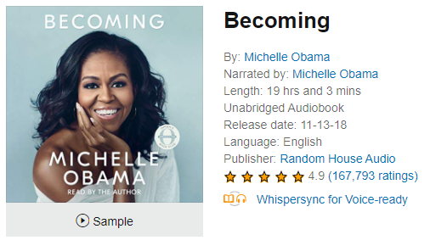
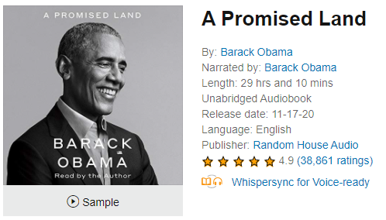
Obama vs. Obama
Self-narrate or pay voice actor.
Actors paid per hour or revenue share.
Some draw to Celebrity self-narration.
Are these books different?
Are they becoming more popular?
Yes
Oprah’s
Book Club?
No

Slide 24
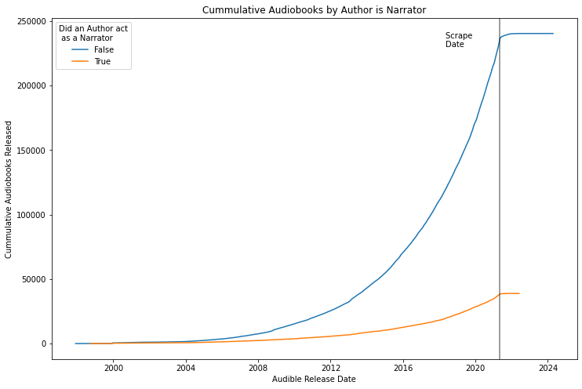
Author as Narrator: Growth
Self-narrating authors since 1998.
Self-narration grows with Audible Library.

Slide 25
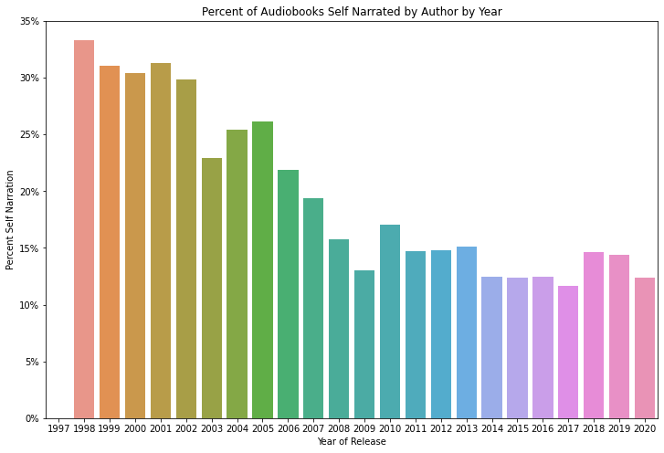
Author as Narrator: Percent of Library
As a percentage, Self-Narration has been decreasing.
In the past decade, it has appeared to stabilize.
Audible originals and translations will further erode this trend.
No distinct advantage across ratings, price, length, or listing.

Slide 26
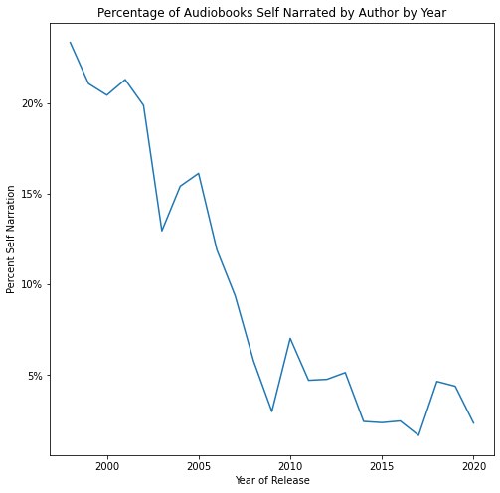

Slide 27
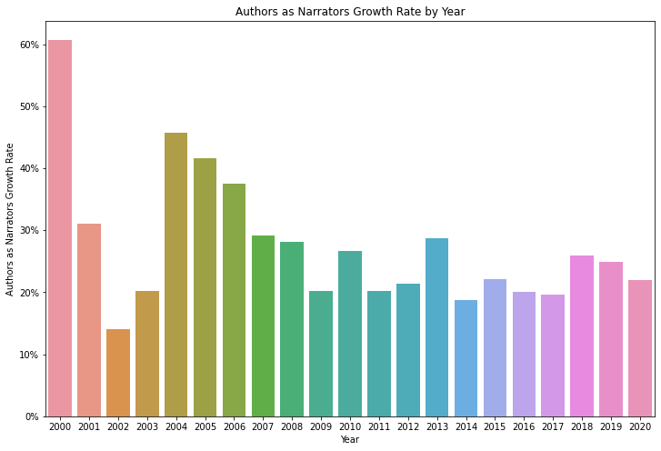
Author as Narrator vs Library Growth

Slide 28
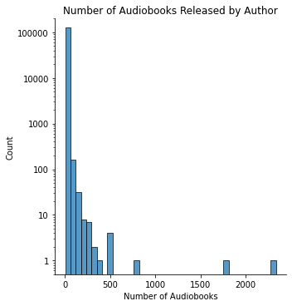
Prolific Authors
Authors | Number of Audiobooks | Type
J. M. Gardner | 2338 | Languages
Charles River Editors | 1755 | History
Innovative Language Learning | 812 | Languages
Pimsleur | 521 | Languages
div. | 501
William Shakespeare | 500 | Public Domain
The Great Courses | 499 | History
Captivating History | 366 | History
Greater Than a Tourist | 351 | Travel
James Patterson | 305 | Prolific
Notes:
King comes in around 136 audiobooks: at 43rd

Slide 29
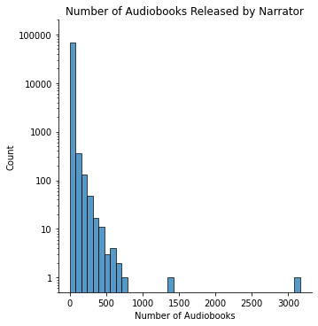
Prolific Narrators
Narrators | Number of Audiobooks | Type
“ ” | 3164
Full cast | 1256 | Collection
Uncredited | 717 | Collection
Scott Brick | 670 | Individual
Al Kessel | 636 | Individual
Cassandra Campbell | 617 | Individual
Simon Vance | 586 | Individual
Intuitive | 567
div. | 566
Pimsleur | 521 | Company

Slide 30
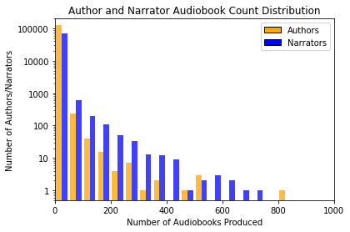
Authors & Narrators
Most authors and narrators produce 1 audiobook.
Mean narrator twice as productive.
Distribution of narrators has a ‘fatter’ tail.
Notes:
127289 Authors (some are working on the same books)
70048 Narratos

Slide 31
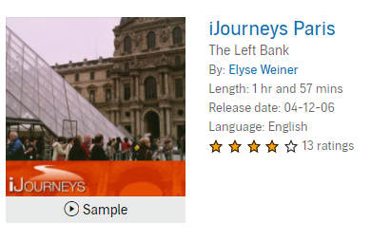
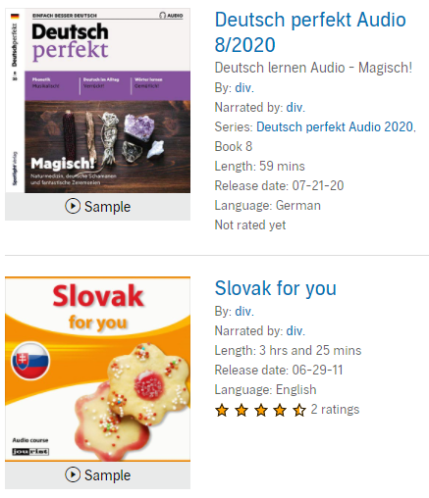
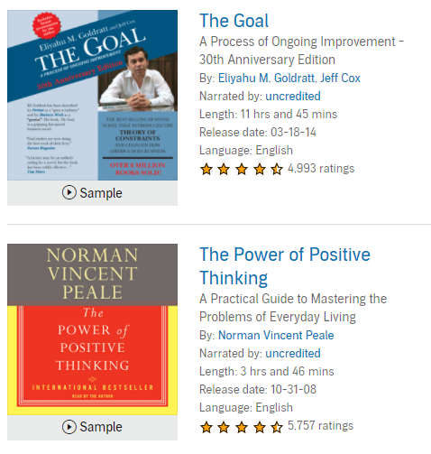
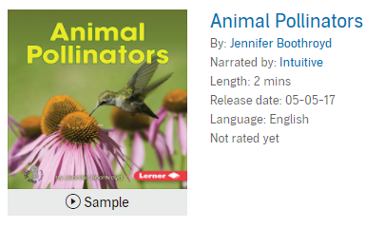
Authors & Narrators

Slide 32
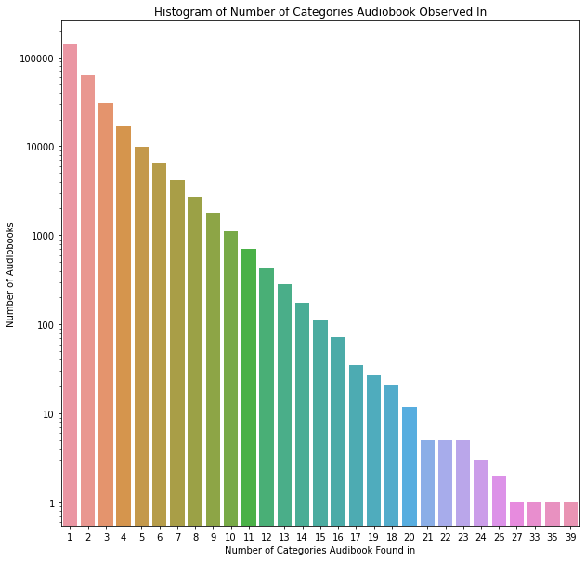
Categories
Categories function like tags.
Most Audiobooks are in 1 category.
History is favored in cross-listing.
# Categories | Title:
39 | Bloodlands: Europe Between Hitler…
35 | Alone Together: Why we expect…
33 | Hitler: A Global Biography
27 | Chernobyl: The history of a Nuclear…
Notes:
Alone Together : Why We Expect More from Technology and Less from Each Other
['Philosophy', 'Workplace Culture’, 'Technology & Society', 'Content Creation & Social Media', 'History & Culture', 'Aging & Longevity', 'Adolescent Psychology’, ’Compulsive Disorders','Anxiety Disorders', 'School-Age Children', 'Teenagers', 'Fatherhood', 'Motherhood', 'Science',

Slide 33
Categories: Greatest (& Worst) Hits
Star Rating
Math
Christian Living
Ministry & Evangelism
Turkish
Slavic Languages
Hebrew
Total Ratings
All Categories
Suspense
Genre Fiction
Turkish
Serbo-Croatian
Flowers & Plants
Length
Americas
Politics & Activism
Epic
Flowers & Plants
Beginner Readers
Nursery Rhymes
Price
Americas
Politics & Activism
Politics & Government
Flowers & Plants
Nursery Rhymes
Beginner Readers
Unique Languages
Southeast Asian Languages
Chinese Languages
French
Step Parenting…
Thanksgiving
Amish & Mennonite
Unique Titles
Action & Adventure
Anthologies & Short Stories
Historical
Adventurers & Explorers
Sexuality & Sexual Health
Latin
Top 3
Bottom 3

Slide 34
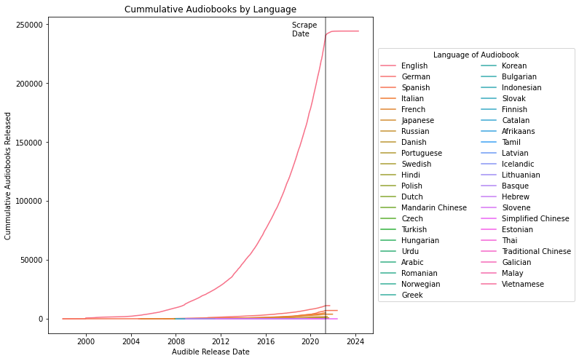
Language
44 languages.
English:
91% Hours
87% Titles
Recent growth isn’t reflected in other languages.
Netflix expanding the offered languages of its content.

Slide 35




Lingua Franca
Targeted landing pages for Chinese, Spanish, and Indian.
All titles are available in main library.
Non-English titles tend to do worse: shorter, cheaper, and less reviewed.
Audible Suno: Free short-form Audible Originals by Indian Writers and Bollywood Stars.
Notes:
This ‘targeted’ strategy still excludes the 82% of Audible titles (conservatively).

Slide 36
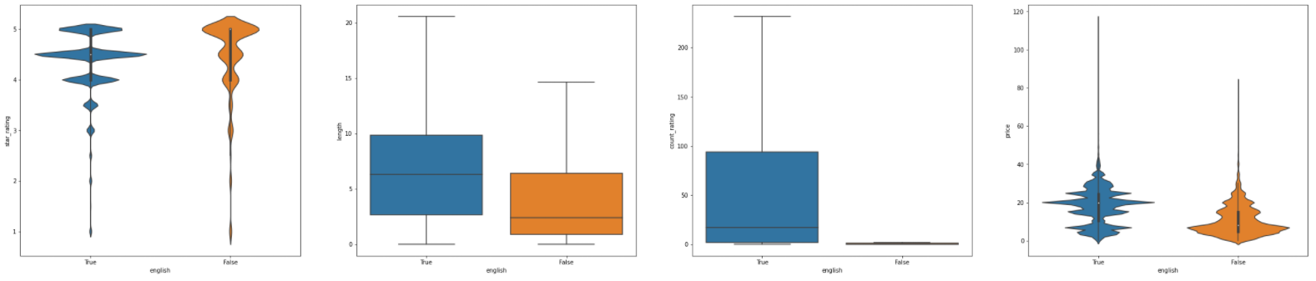
Lingua Franca
Non-English titles tend to be shorter, sell for less, and garner fewer reviews. There seem to be more 5-star reviews however that is likely due to the low review count.
Star Rating
Length
Number of Ratings
Price
English Non-English
English Non-English
English Non-English
English Non-English

Slide 37
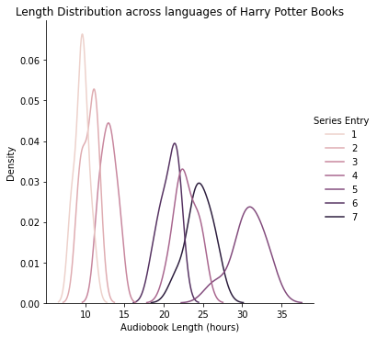
Translation: Bottom-Up
Translation changes the length of audiobooks.
Used Harry Potter translations to compute standard deviation for each entry.
Average percent standard deviation across languages is 7.4% of the length.
Unfortunely this led to many false negatives.
Harry Potter Book

Slide 38

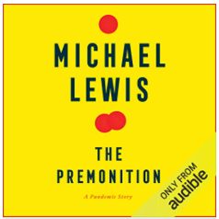

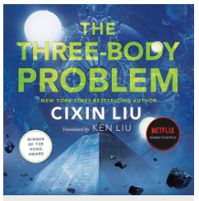
Translation: Top-Down
Consumers purchase and retain if they have choice.
Audible already holds some rights.
Production costs are linear at $200 / finished hour.
Scale or revenue sharing could further reduce price.

Slide 39
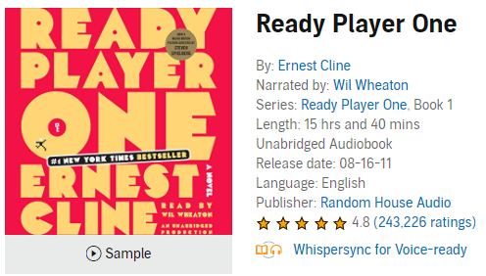
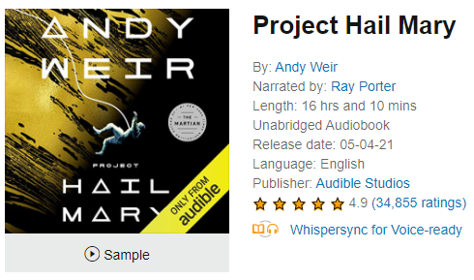
Conclusions
Past
Present
Future
All Time Most Reviewed
Top Seller
My First Audiobook
Audible Originals
Make the market
Recent Listen
Expansion
Grow the market
Reading List Addition

Slide 41
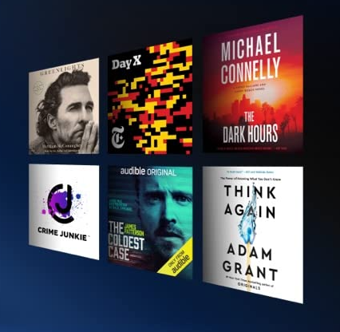

Conclusions
All Audible data is skewed.
Price and Length are correlated.
Audible has 44 languages but few titles in growing languages.
Audible is behind on translation which will be the main source of growth in the future.

Slide 42
Future Work
Dig Deeper
Podcasts & Audible Originals
Category Analysis
Notes:
Category information
Podcasts
Audible data collection could be expanded by fine grain review data.
More creative graphs
Better formatting in the notebook
Felt like I couldn’t find a through line
Capture plus vs premium plus titles?
Audible might have dynamic categories. Number of titles increased and decreased across categories.

Slide 43
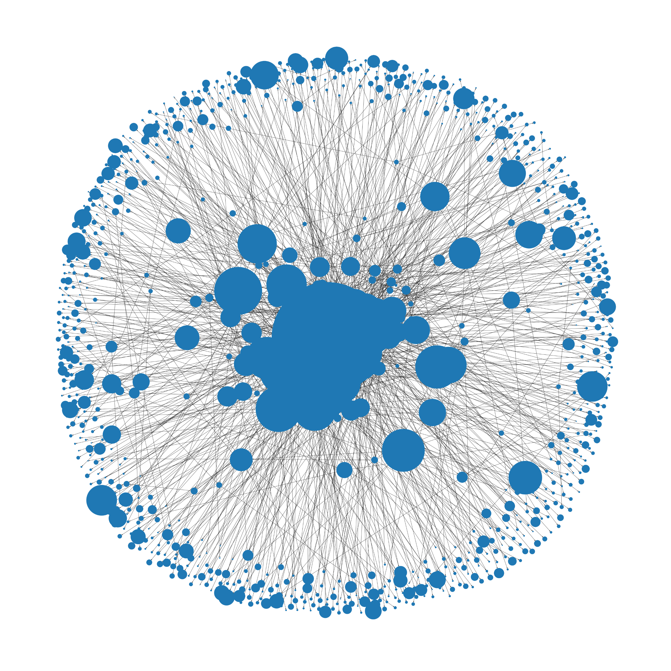
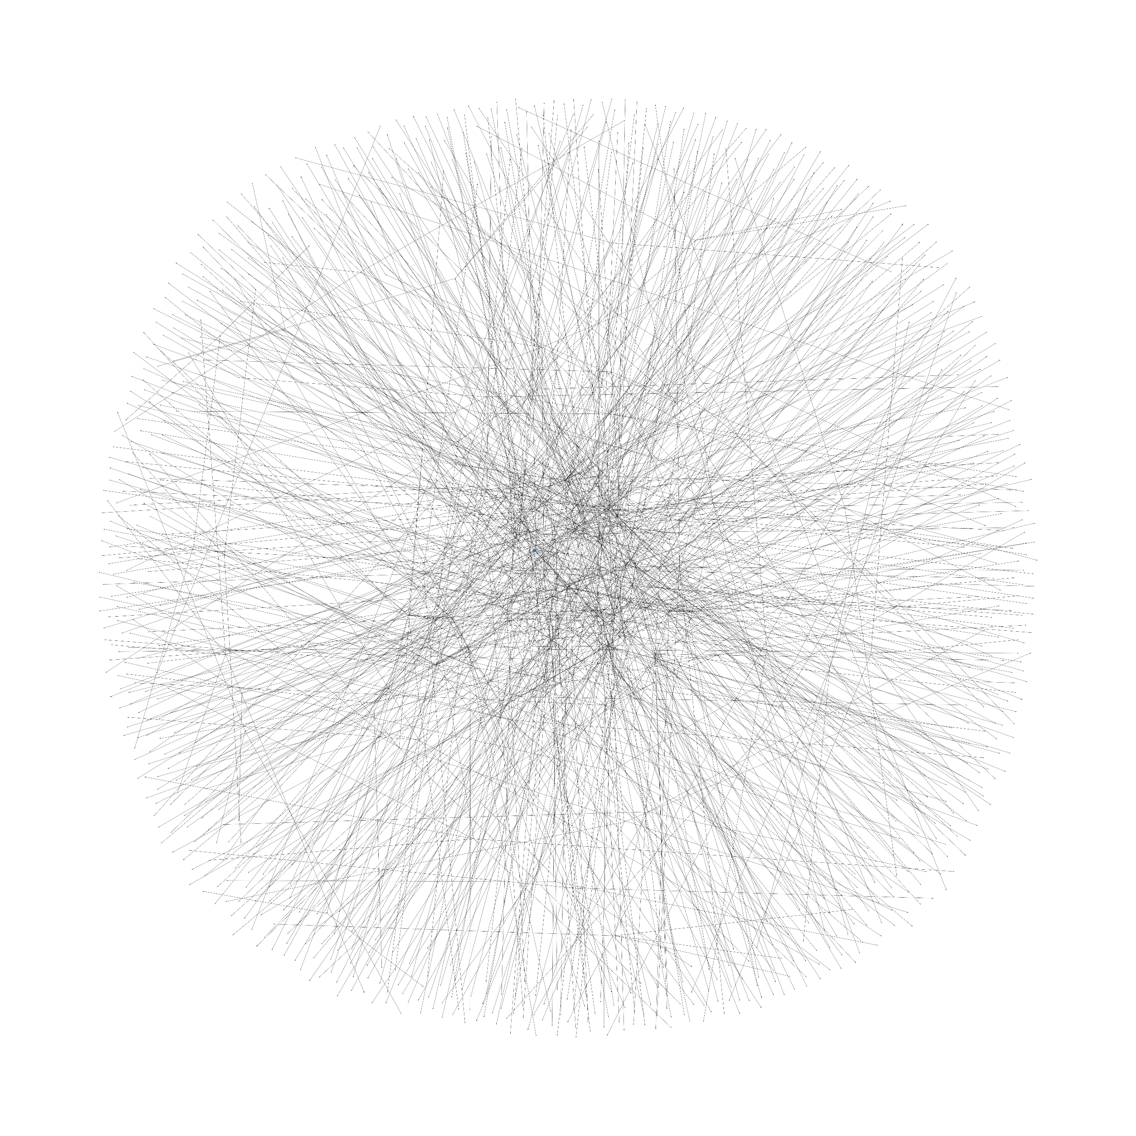
Future Work: Categories

Slide 44
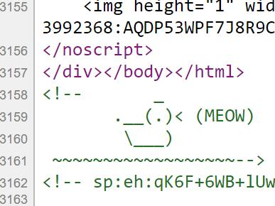
Future Work
Attempted to scrape Amazon books
Roadblock: CAPTCHA after 500 page visits
Solution: ScraperAPI proxy service
Alternative Approach
Bookshop.org
Similar selection & data
Prices are slightly elevated

Slide 45
Acknowledgements
Audible for not banning me; screenshots
ScraperAPI for help which I didn’t end up using in this project.
Ed Robertson & Unsplash for the photo.
And Viewers like you, thank you

Slide 46
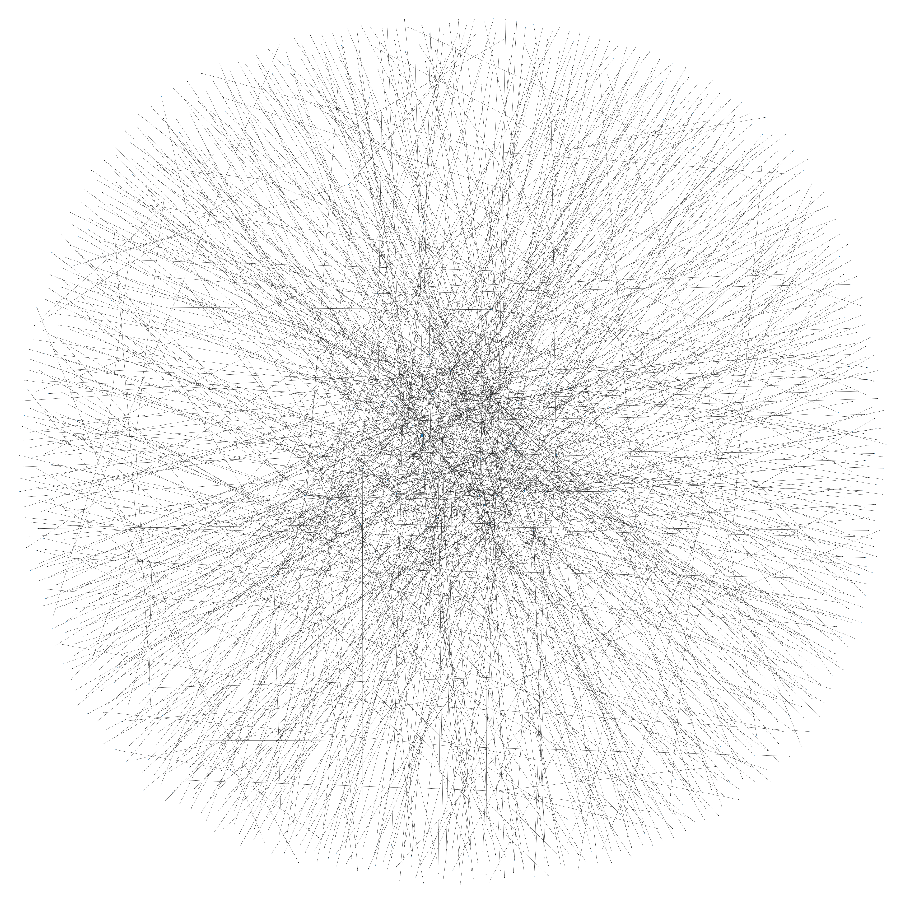
Questions?

